Slide 1


NETFLIX DATA ANALYSIS DASHBOARD
An end-to-end Data Analytics Project (Excel + SQL + Power BI)

Slide 2
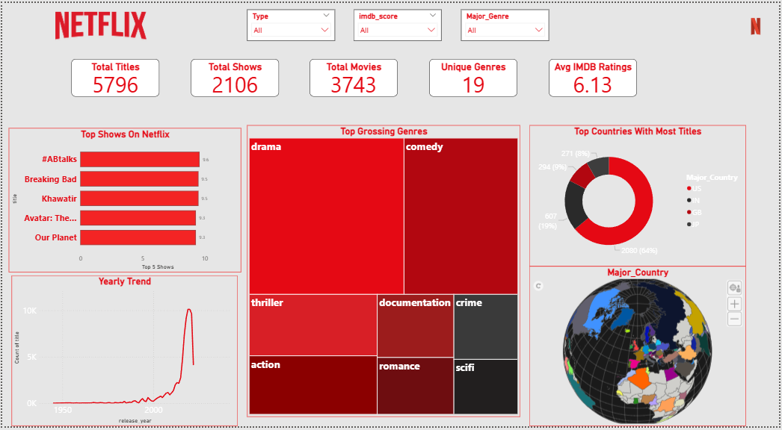
PROJECT OVERVIEW
This is analytical dashboard of netflix’s platform data.
KPIs: To give a quick overview of underlying data.
Graphs/Barcharts: Each divulges different kinds of aggregated information for instance: Top 5 Titles by IMDB score.
Filters: Gives information about different segments of data and makes the dashboard interactive.
Tools Used
Excel
SQL
Power BI
Cleaned the raw data and handled nulls and blanks.
Prototyping of aggregate queries
Further Cleaned data through power query. Visualized the data and converted into a dashboard

Slide 3
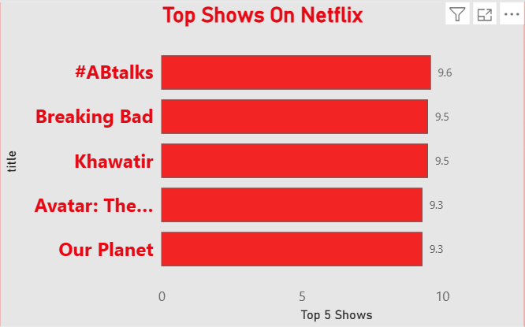
Through this we can easily analyze and see the top shows that are watched and rated by the majority of people.
The bar chart shows the highest imdb rated shows and the score in a easy manner.

Slide 4
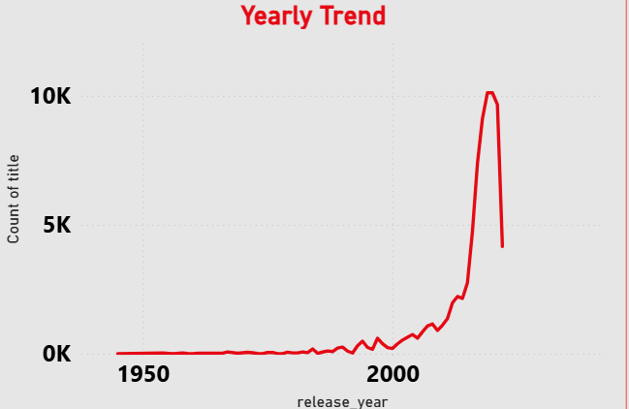
This shows the yearly trend of number of titles released each year.
The line chart shows how much the trend changes through different years.

Slide 5
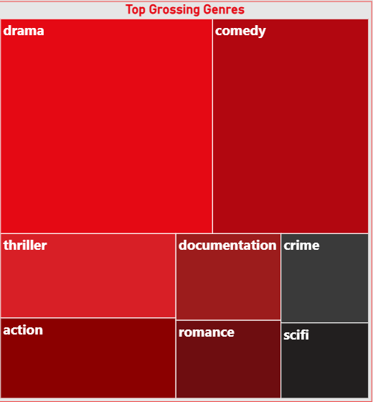
This treemap shows the top grossing genres that are trending on netflix.
The treemap easily sums all the genre in a chart and assigns the highest with maximum segment.

Slide 6
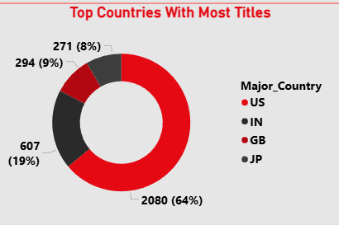
This donut chart shows the top countries that produced the most number of titles.
Through donut chart we can easily understand the top most countries from a large dataset

Slide 7
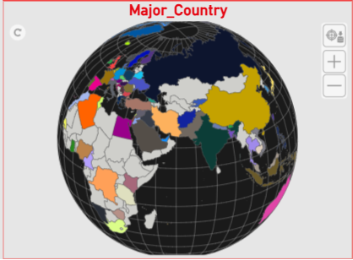
Globe Chart showcases different countries that shows the information about it.
This dynamic globe makes it easier to understand the information of many countries in the easiest manner.

Slide 8
Conclusion
Netflix’s library is dominated by movies (around 65%).
Drama and Comedy emerged as the most popular genres.
The United States leads in content production.
A sharp growth trend in releases is seen after 2015.
Average IMDb rating of 6.3 reflects moderate audience satisfaction

Slide 9
Rishav Punia

